Slide 1
PRAM 2 Graph algorithms
CS121 Parallel Computing
Spring 2021

Slide 2
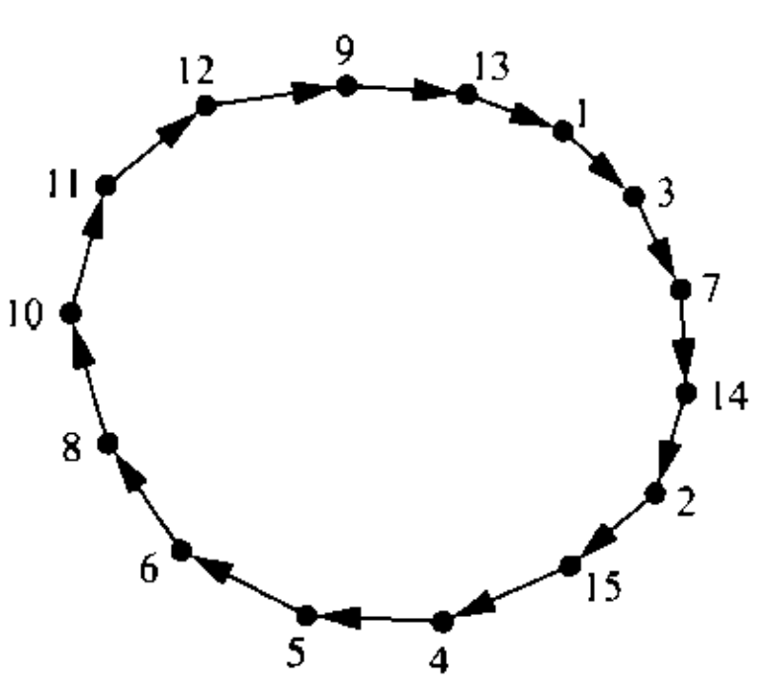
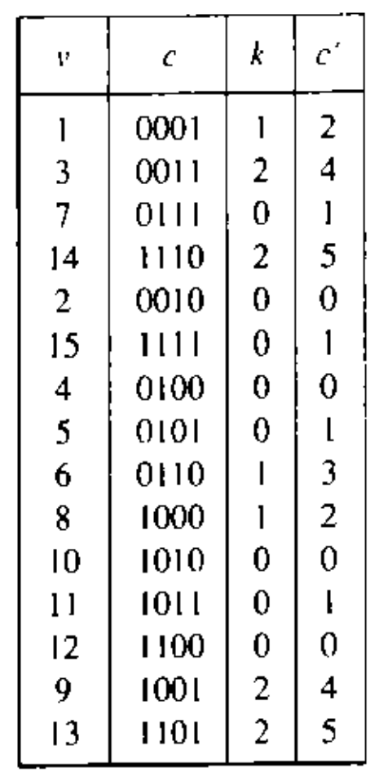
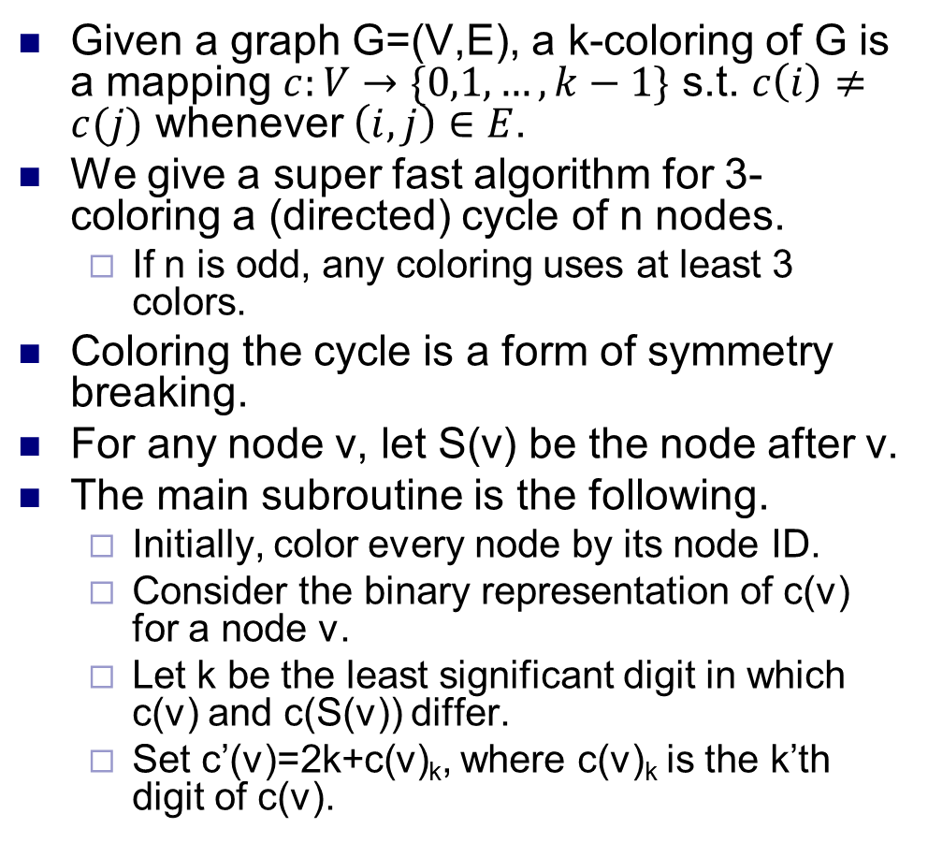
Coloring a cycle
Given a graph G=(V,E), a k-coloring of G is a mapping $c:V→\{0,1,…, k−1\}$ s.t. $c\left(i\right)≠c(j)$ whenever $\left(i,j\right)∈E$.
We give a super fast algorithm for 3-coloring a (directed) cycle of n nodes.
If n is odd, any coloring uses at least 3 colors.
Coloring the cycle is a form of symmetry breaking.
For any node v, let S(v) be the node after v.
The main subroutine is the following.
Initially, color every node by its node ID.
Consider the binary representation of c(v) for a node v.
Let k be the least significant digit in which c(v) and c(S(v)) differ.
Set c’(v)=2k+c(v)_{k}, where c(v)_{k} is the k’th digit of c(v).

Slide 3
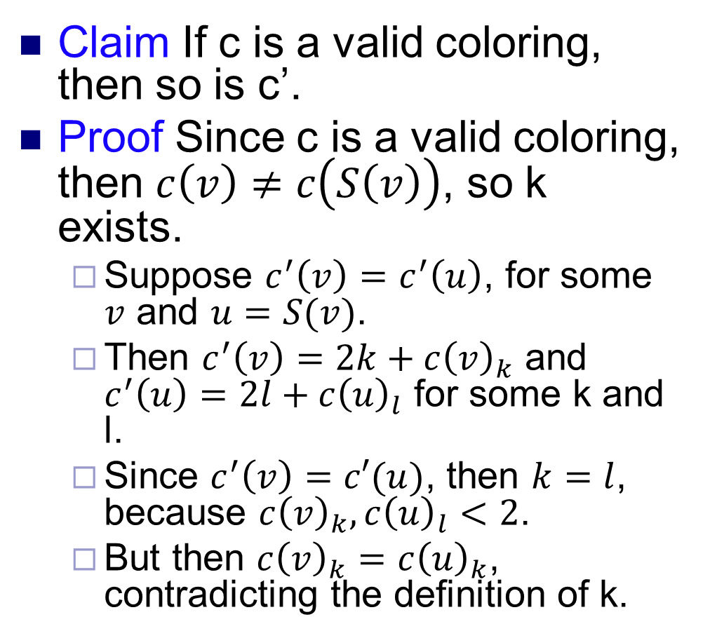
Coloring a cycle
Claim If c is a valid coloring, then so is c’.
Proof Since c is a valid coloring, then $c\left(v\right)≠c\left(S\left(v\right)\right)$, so k exists.
Suppose $c^{′}\left(v\right)=c^{′}\left(u\right)$, for some $v$ and $u=S(v)$.
Then $c^{′}\left(v\right)=2k+c{\left(v\right)}_{k}$ and $c^{′}\left(u\right)=2l+c{\left(u\right)}_{l}$ for some k and l.
Since $c^{′}\left(v\right)=c′(u)$, then $k=l$, because $c{\left(v\right)}_{k}, c{\left(u\right)}_{l}<2$.
But then $c{\left(v\right)}_{k}=c{\left(u\right)}_{k}$, contradicting the definition of k.

Slide 4
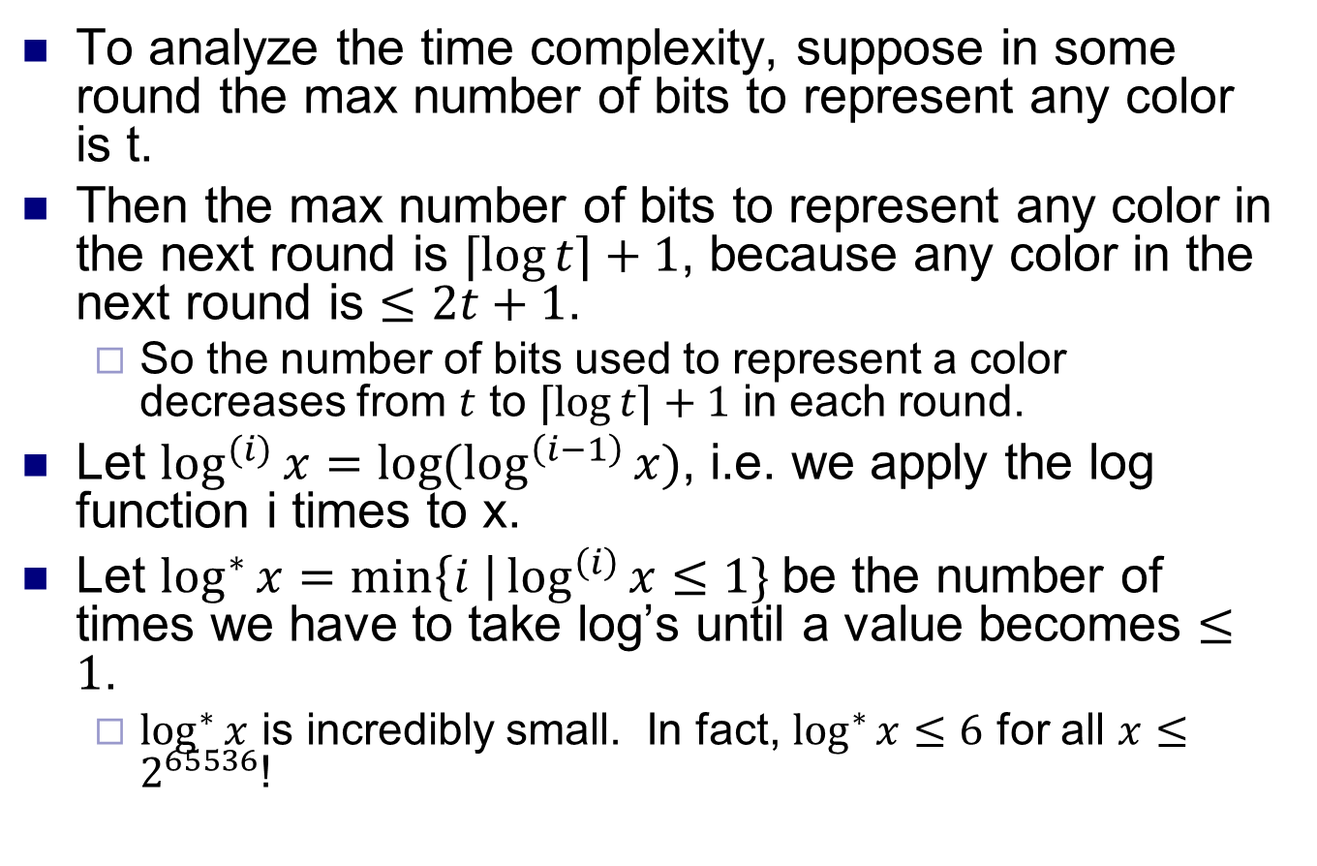
Coloring a cycle
To analyze the time complexity, suppose in some round the max number of bits to represent any color is t.
Then the max number of bits to represent any color in the next round is $⌈\log{t⌉+1}$, because any color in the next round is $≤2t+1$.
So the number of bits used to represent a color decreases from $t$ to $⌈\log{t⌉+1}$ in each round.
Let $\log^{(i)}{x=\log{(\log^{\left(i−1\right)}{x)}}}$, i.e. we apply the log function i times to x.
Let $\log^{∗}{x=\min\left\{i \right|\log^{\left(i\right)}{x≤1\} }}$be the number of times we have to take log’s until a value becomes $≤1$.
$\log^{∗}{x}$ is incredibly small. In fact, $\log^{∗}{x≤6}$ for all $x≤2^{65536}$!

Slide 5
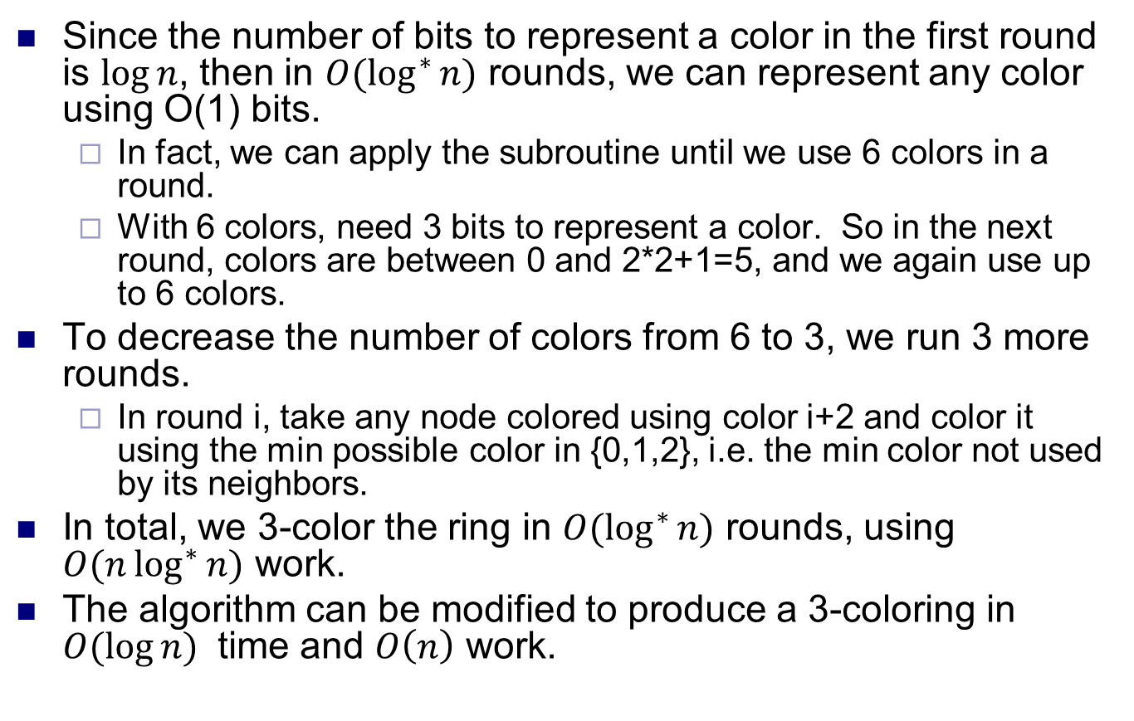
Coloring a cycle
Since the number of bits to represent a color in the first round is $\log{n}$, then in $O(\log^{∗}{n)}$ rounds, we can represent any color using O(1) bits.
In fact, we can apply the subroutine until we use 6 colors in a round.
With 6 colors, need 3 bits to represent a color. So in the next round, colors are between 0 and 2*2+1=5, and we again use up to 6 colors.
To decrease the number of colors from 6 to 3, we run 3 more rounds.
In round i, take any node colored using color i+2 and color it using the min possible color in {0,1,2}, i.e. the min color not used by its neighbors.
In total, we 3-color the ring in $O(\log^{∗}{n)}$ rounds, using $O(n\log^{∗}{n})$ work.
The algorithm can be modified to produce a 3-coloring in $O(\log{n) }$ time and $O\left(n\right)$ work.

Slide 6
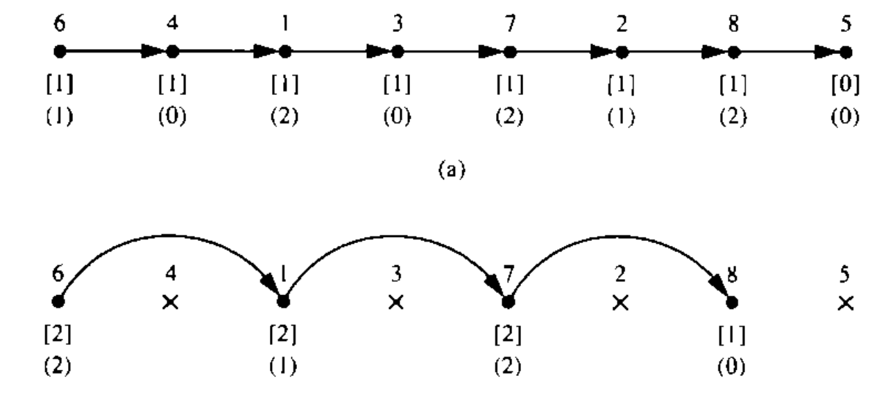
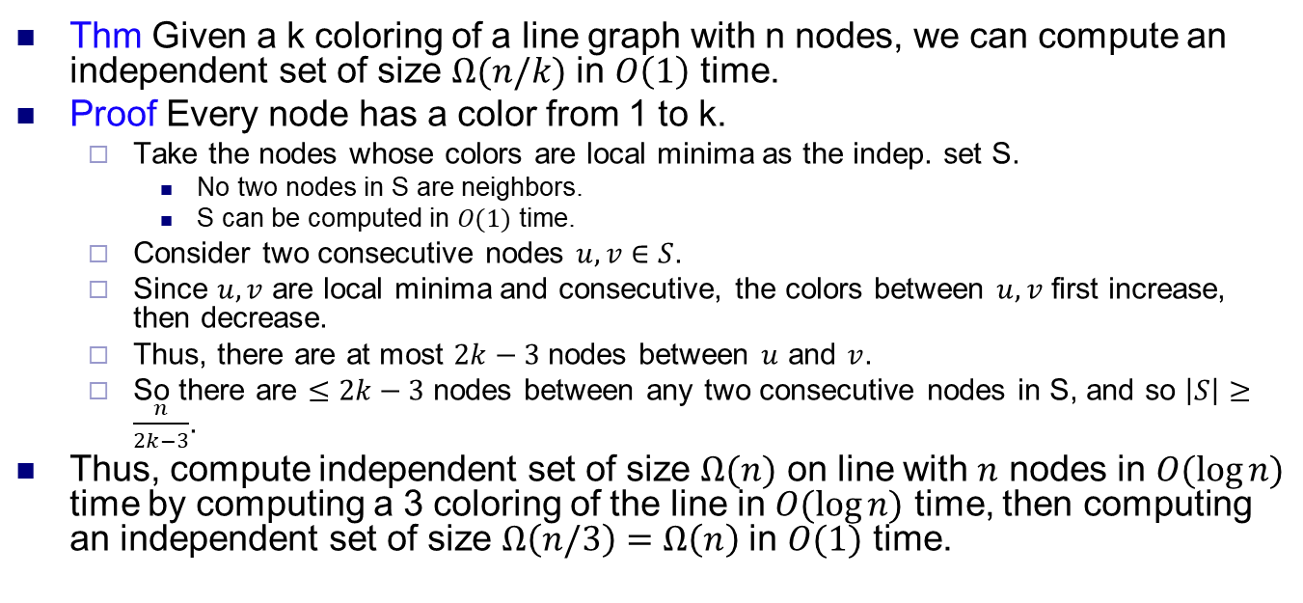
Independent set on line
Thm Given a k coloring of a line graph with n nodes, we can compute an independent set of size $Ω(n/k)$ in $O\left(1\right)$ time.
Proof Every node has a color from 1 to k.
Take the nodes whose colors are local minima as the indep. set S.
No two nodes in S are neighbors.
S can be computed in $O(1)$ time.
Consider two consecutive nodes $u,v∈S$.
Since $u,v$ are local minima and consecutive, the colors between $u,v$ first increase, then decrease.
Thus, there are at most $2k−3$ nodes between $u$ and $v$.
So there are $≤2k−3$ nodes between any two consecutive nodes in S, and so $\left|S\right|≥\frac{n}{2k−3}$.
Thus, compute independent set of size $Ω(n)$ on line with $n$ nodes in $O(\log{n)}$ time by computing a 3 coloring of the line in $O(\log{n)}$ time, then computing an independent set of size $Ω\left(n/3\right)=Ω\left(n\right)$ in $O(1)$ time.
The colors of the nodes are shown in parentheses.
Nodes 4, 3, 2, 5 are local minima.

Slide 7
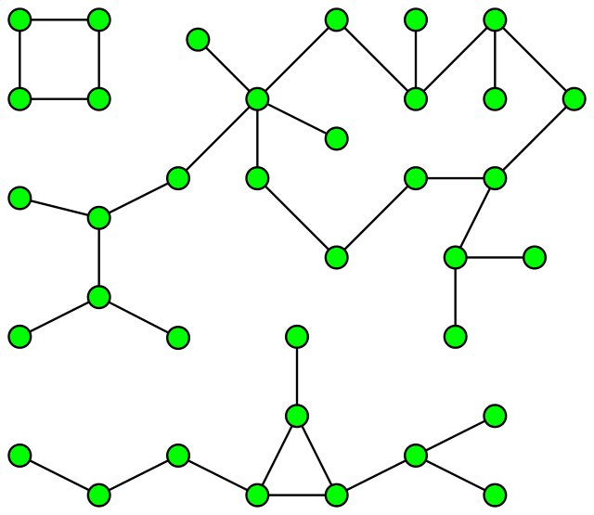
Connected components
Given an undirected graph, partition it into maximal sets of nodes that are connected to each other.
Can be solved sequentially in O(m+n) time using BFS / DFS.
m is number of edges, n is number of vertices.
However, no efficient BFS / DFS PRAM algorithms known.
Instead, use graph contractions.
In each phase, merge (contract) a set of connected nodes into a supernode.
Form a contracted graph on the supernodes, then apply algorithm recursively.
Eventually each connected component is contracted to one node.
Many different algorithms, depending on which nodes they contract.

Slide 8
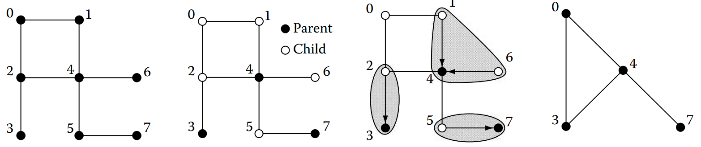
Randomized parallel algorithm
Break graph into star graphs and contract each star.
In each phase, do the following steps in parallel.
Every node flips a coin and chooses to be a parent or child node.
Each child node points to a parent node it’s connected to.
Now have a set of stars, with the parent nodes as the centers.
If child not connected to any parent node, it forms its own star.
Contract each star to its center, then apply algorithm recursively.
Label all nodes in star by the label of the parent.
Keep the edges between differently labeled nodes.
After recursion returns, each child with a parent again takes parent’s label, which might have changed.
Source: Algorithms and Theory of Computation Handbook, Chapter 25

Slide 9
Implementation
Use n+m processors, one processor for each vertex and edge.
Call these V and E procs, resp.
Each V proc has a label which can change over time.
Each E proc responsible for edge (u,v), where u, v are V procs.
V and E procs may become inactive over time.
In each phase, each active V proc flips a coin to decide if it’s a child or parent proc.
Each active E proc (u,v) checks if u is a child proc and v is a parent (or vice versa).
If so, it sets u’s label to v (or v’s label to u).
Another E proc (u,v’) could set u’s label to v’. In this case, either the v or v’ write succeeds.

Slide 10
Implementation
Each parent V proc, or child V proc whose label didn’t change (i.e. it had no parent), stays active.
Other V procs become inactive.
Each active E proc (u,v) where u, v have different labels stays active.
Other E procs become inactive.
From now on, E will be responsible for V processes (u’,v’), where u’ and v’ are the labels of u and v, resp.
The active V and E procs run the algorithm recursively.
After recursion returns, inactive E procs (u,v) (where u is the child) write v’s label to u.
At end, all V procs in a connected component have same label.

Slide 11
Complexity
Key fact is that number of active V procs decreases by 1/4 fraction in expectation each phase.
A V proc becomes inactive if it’s a child node and one its neighbors is a parent node.
The former probability is 1/2, and the latter is ≥ 1/2.
Thus each V proc becomes inactive with probability ≥ 1/4.
With high probability, after O(log n) phases, there’s only one V proc and recursion ends.
Each phase takes O(1) time, and does O(m+n) work.
Total time is O(log n), total work is O((m+n) log n).
This algorithm isn’t work efficient.
There exist work efficient randomized CC algorithms.

Slide 12
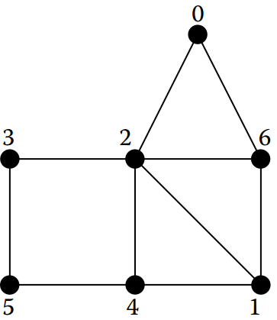
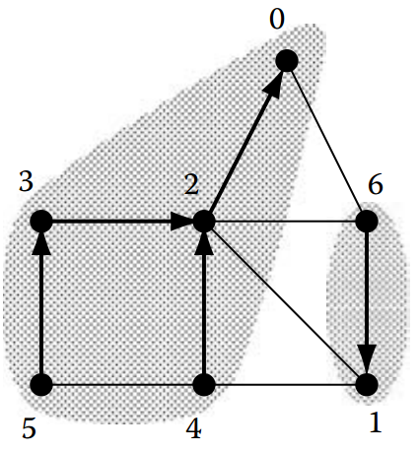
Deterministic parallel algorithm
Again work in phases, with following parallel steps.
Each node points to a neighbor with lower ID.
This breaks graph into a directed forest.
Contract each forest to the lowest ID node using pointer jumping.
Recurse on contracted graph.

Slide 13
Implementation
As before, use n+m procs, for V and E.
But now, V procs always active. E procs may become inactive.
Each E proc (u,v) checks if u<v, and if so sets v’s label to u.
Again, conflicts resolved arbitrarily.
V procs then apply pointer jumping on the labels, taking the label of the proc it points to.
Each active E proc (u,v) where u, v have different labels stays active. Other E procs become inactive.
The V procs and active E procs run algorithm recursively.
Note that in recursive call, all V procs apply pointer jumping.

Slide 14
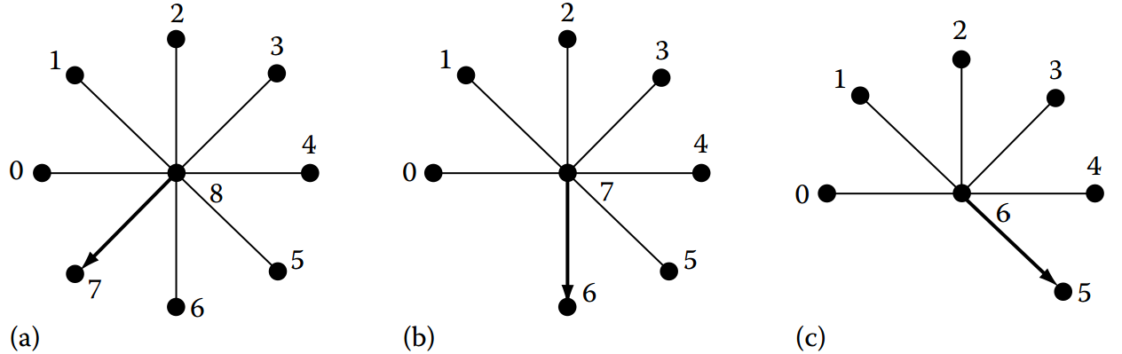
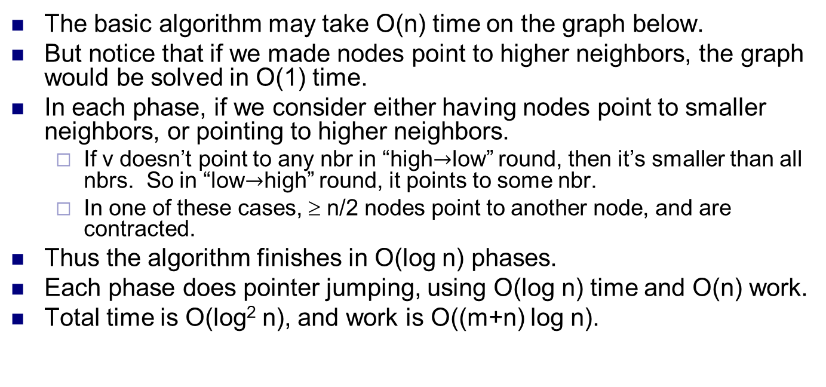
Complexity
The basic algorithm may take O(n) time on the graph below.
But notice that if we made nodes point to higher neighbors, the graph would be solved in O(1) time.
In each phase, if we consider either having nodes point to smaller neighbors, or pointing to higher neighbors.
If v doesn’t point to any nbr in “high$→$low” round, then it’s smaller than all nbrs. So in “low$→$high” round, it points to some nbr.
In one of these cases, ≥ n/2 nodes point to another node, and are contracted.
Thus the algorithm finishes in O(log n) phases.
Each phase does pointer jumping, using O(log n) time and O(n) work.
Total time is O(log² n), and work is O((m+n) log n).

Slide 15
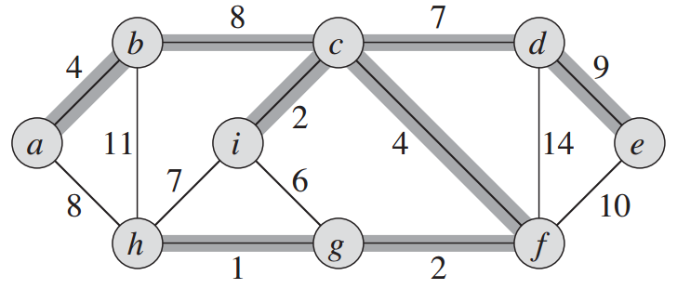
Minimum spanning tree
Given an undirected graph with edge weights, an MST is a connected subgraph containing all the vertices, which has minimum total weight.
Can be solved in O(m + n log n) time sequentially by a greedy algorithm.
Key property is that for any set of vertices W, the minimum cost edge from W to V \ W is in the MST.
So for any vertex v, min cost edge containing v is in MST.
Will describe a parallel MST algorithm based on the randomized parallel algorithm for connected component.
Source: Introduction to Algorithms, Cormen et al.

Slide 16
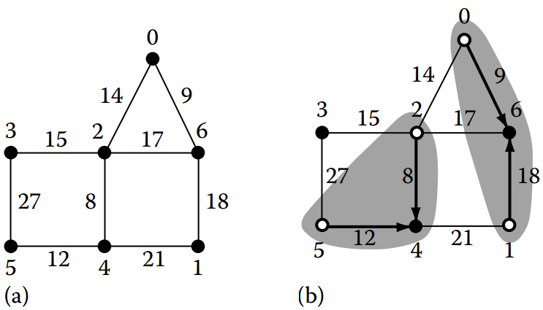
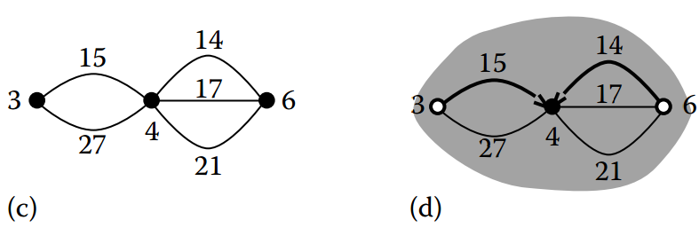
Randomized parallel algorithm
Each node randomly chooses to be a parent or child node.
Each child node u finds min weight incident edge (u,v), and points to v if v is parent.
This forms a set of stars with parents as centers.
If v isn’t a parent, u forms its own star.
Contract each star to the parent, and run algorithm recursively.
How do we find min weight incident edge in O(1) time?
One possibility is to use priority CRCW.
Presort the edges by nondecreasing weight. Each edge processor’s priority is its value.
So when each E proc (u,v) writes to u, min weight edge wins.

Slide 17
Complexity
At least 1/4 of vertex processors become inactive each phase in expectation.
Given a node u and min weight edge (u,v), there’s 1/4 probability u is child and v is parent.
Thus, there are O(log n) phases with high probability.
Finding min weight incident edge takes O(1) time after presorting edge weights.
Total time is O(log n), total work is O((m+n) log n).

